Slide 1

Body Language
Comic Strip Activity

Slide 2
Comic strip Activity
You will have one lesson only to complete a comic strip to demonstrate your understanding of body language. Please ensure you plan to have your comic strip completed in the 64 minutes of this lesson.
Your comic strip must have at least 2 frames, and must contain at least 4 different forms of non-verbal communication – either facial expressions of body language.
You must label, under the comic strip slide, the non-verbal communication you have demonstrated.

Slide 3
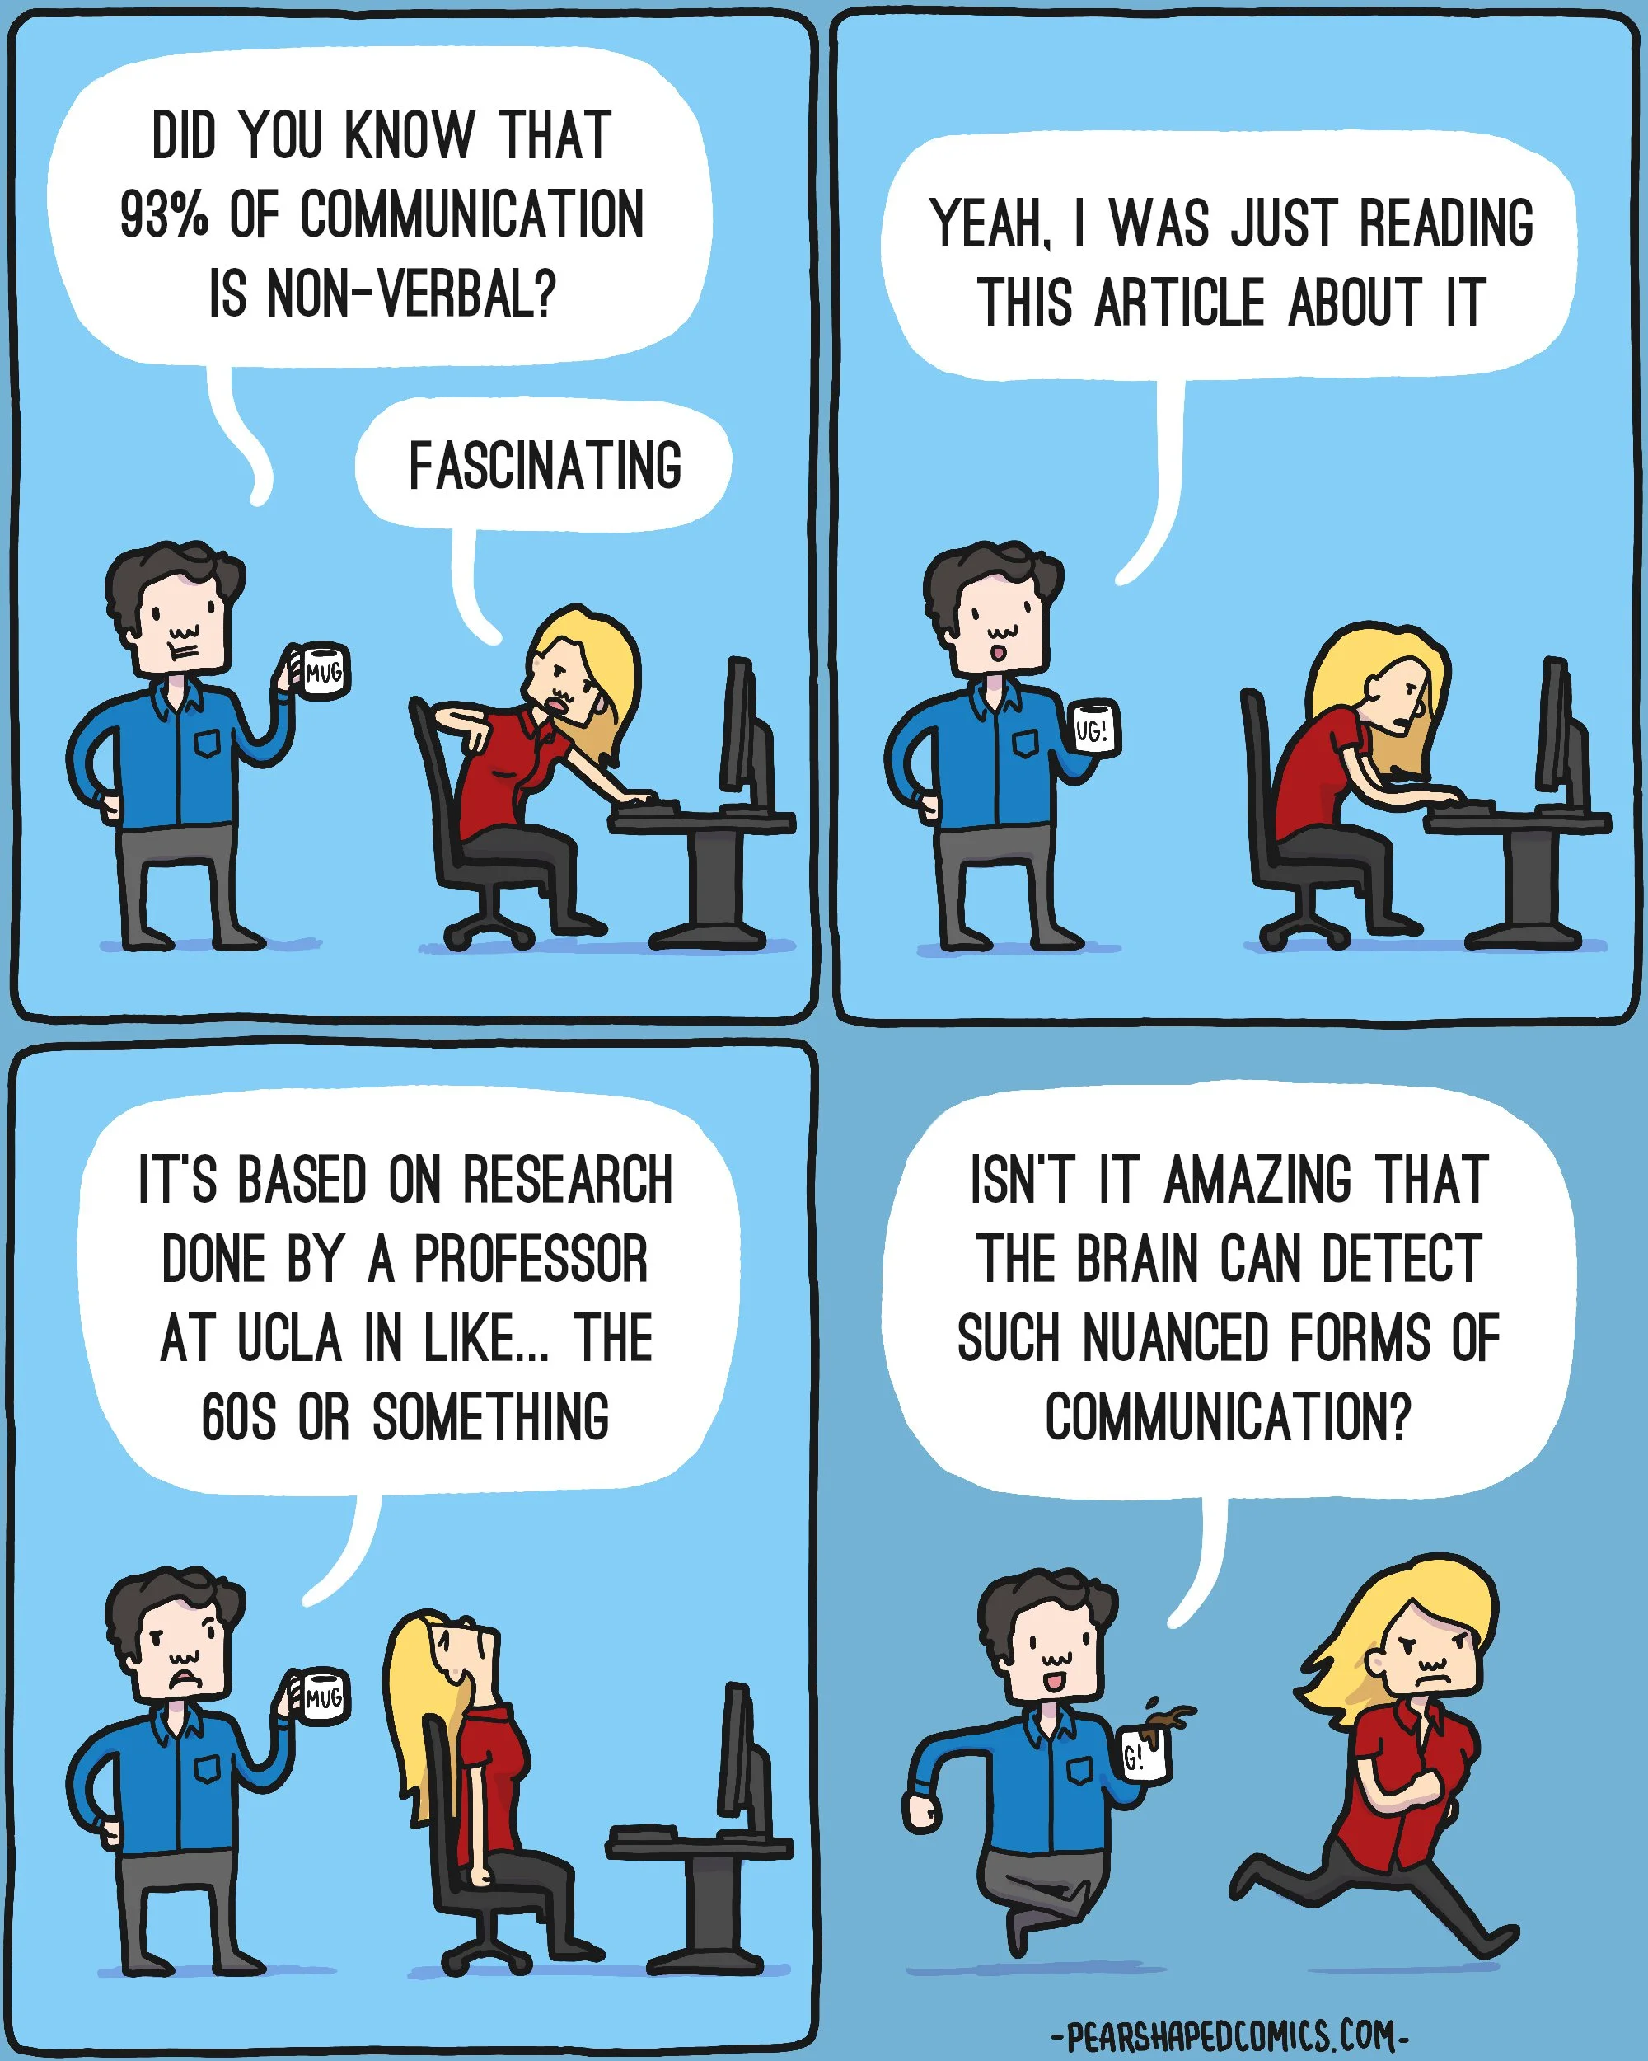

Slide 4
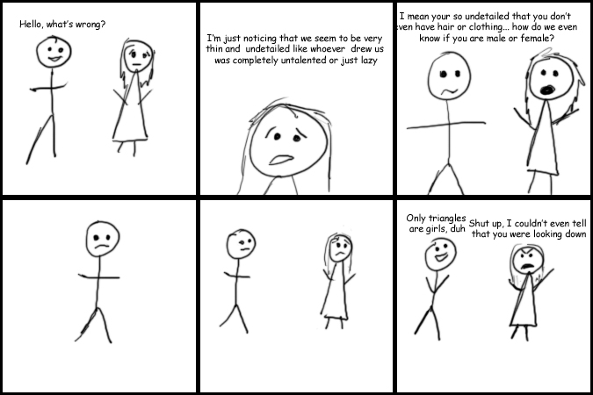

Slide 5
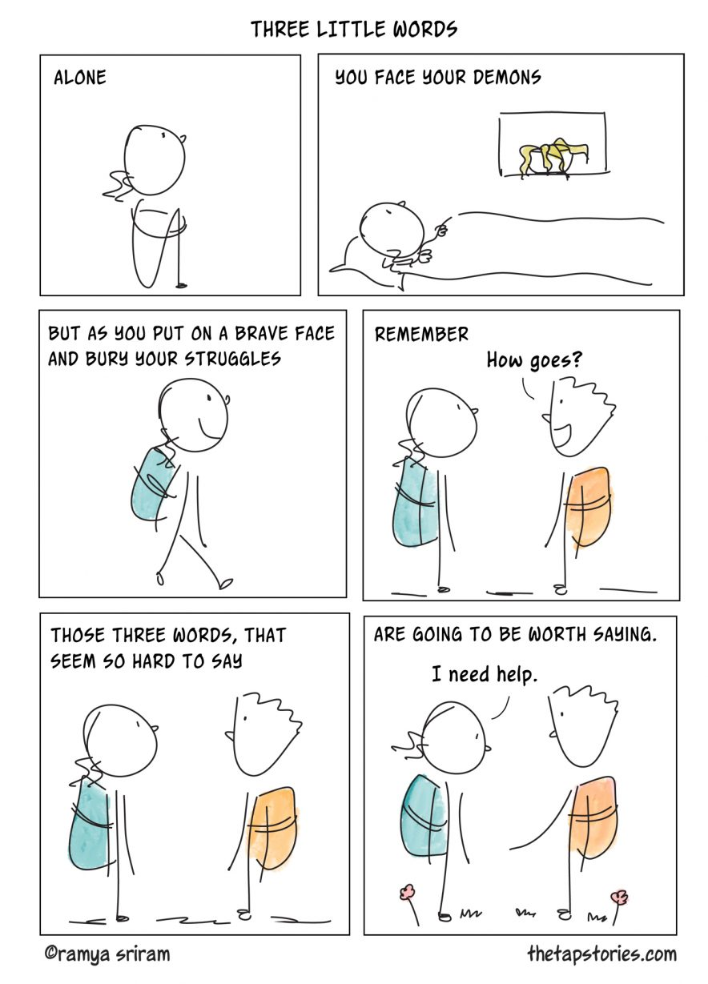

Slide 6
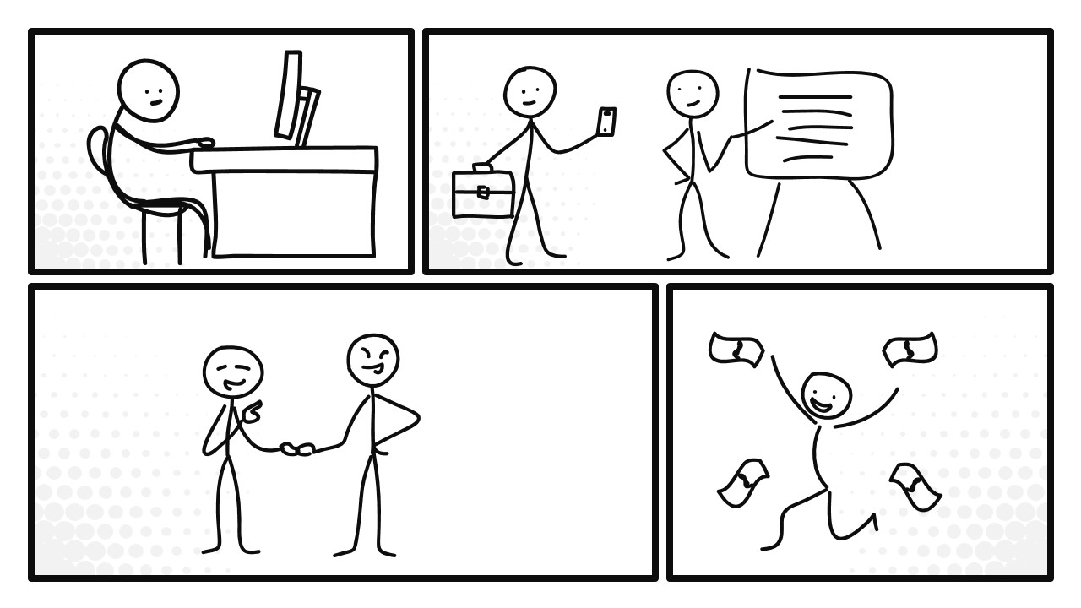

Slide 7
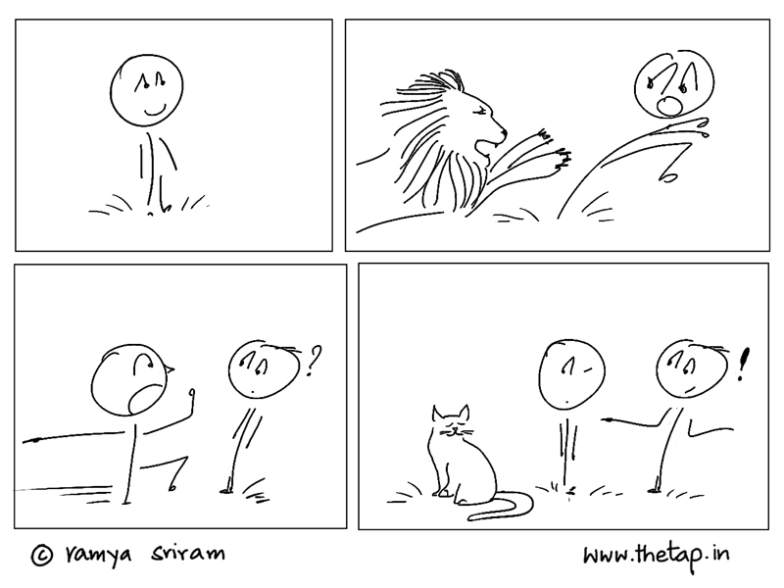

Slide 8
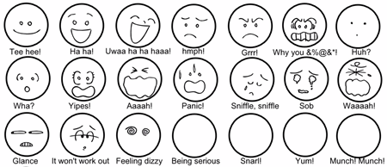

Slide 9
